Slide 1

Class of 2020 Parent/Student College Planning Night
August 7, 2019
6:30pm
Notes:
Welcome to the Class of 2020 Parent/Student College Planning Night! We are glad you’re here and hope you find this evening to be very beneficial.

Slide 2








Meet Your Counselor – Grades 10-12
Mr. Girtz
A-Bur,
Warf-White, C
Mrs. Girton
L-Mos,
Vim-Ware
Mr. Corn
Bus-El, Williams,
S-Woodruff
Ms. Gates
Mot-Ro,
Vid-Vil
Mr. Marshall
Em-Hel,
White, D-Williams, C
Mr. Shelby
Rp-Th,
Woods-Z
Mrs. Fleming
Hem-K,
Ti-Vic
Miss Williams
ENL Students
Notes:
Meet your counselor.

Slide 3
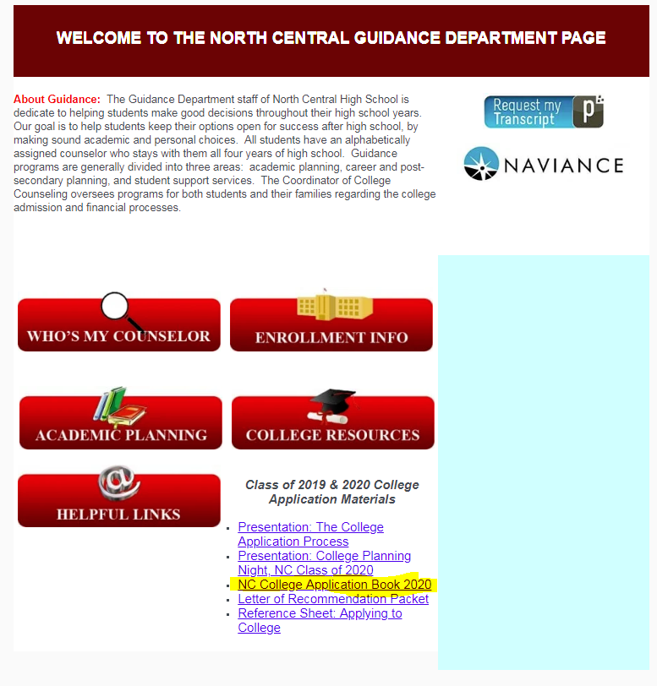





Resources
*Check out the Counseling YouTube page: NCHS_College, Career, and Counseling
*Follow us on Twitter: @NcCounselors
Notes:
The College Handbook is your go-to resource for answers to the following questions, including: Finding the right fit and comparing colleges, making the most of your college visit, navigating scholarships and financial aid, and much more!
Naviance Student is an excellent college and career tool. Not sure what you want to do after high school? Complete the Career Interest Profiler, take the Strengths Explorer, and check out the Career Key. These can all be found under the About Me tab.
The counseling YouTube channel is another great resource for you. We will be posting short videos that you can easily access at any point during your journey this year.
Lastly, be sure to talk with your counselor or Miss Salazar, College and Career Counselor. We are here to help you as we know this can be an overwhelming process.

Slide 4
Senior Year Timeline
August -September Research, remaining testing, and begin to apply early
*ALL YEAR* Look for Scholarships
January - April Review financial aid offers, FAFSA deadline(s), regular applications
October - December Remaining testing, applications, and financial aid steps
May 1 National Candidate Reply Date!
Notes:
Look at your handout to see a more specific senior year timeline. We hope this timeline helps to get you and your student organized as we know this can be an overwhelming time.

Slide 5
ACT and SAT
4 year colleges and universities require students take the ACT and/or the SAT
  May take one or both
When registering, be sure to list 4 colleges/universities to have your scores sent to for FREE
Students applying to schools with a November 1 priority deadline must have an SAT or ACT score in order for your application to be considered complete
Colleges will accept higher SAT or ACT scores for scholarship consideration, as long as initial deadlines are met
ACT and SAT fee waivers
Students receiving free/reduced lunch can take one free SAT and ACT per school year.
Students who have previously used a fee waiver will see all of their remaining fee waivers on their College Board account dashboard online.
Notes:
4 year colleges and universities require students take the ACT and/or the SAT.
More and more colleges are requiring SAT and ACT scores to be sent directly from the testing agency. Because of this new requirement, it is important that your student selects up to 4 schools to send their scores to when registering for the ACT or SAT. If you must send scores directly from the testing agency after the fact, there is a fee involved.
Many colleges have a November 1 priority deadline for scholarship consideration. This means all materials must be submitted by that date for their application to be considered complete. If your student does not yet have a test score and wants to meet the November 1 priority deadline, please encourage your student to register for the August SAT or the September ACT at North Central High School.
As long as your student has all materials submitted by the November 1 priority deadline, students can continue to take the SAT and/or ACT again for scholarship consideration.

Slide 6

Fall SAT Test Dates
Register online: www.sat.collegeboard.org
SAT customer service: 866-630-9305
Test Date | Registration Deadline | Late Registration Deadline (extra fee applies)
 |  | Mail | Phone/Online
*August 24 | July 26 | August 6 | August 13
October 5 | September 6 | September 17 | September 24
*November 2 | October 3 | October 15 | October 22
December 7 | November 8 | November 19 | November 26
*North Central HS is a test site location
Seniors must choose North Central at the time of registering for test(s) to ensure test scores are on the NC transcript. ACT or SAT scores are not automatically sent to NC.
Notes:
If your student has not yet taken one of these exams and plans to apply to a 4 year college, please be sure that your student gets registered as soon as possible. North Central hosts the August 24 SAT.

Slide 7

Fall ACT Test Dates
Register online: www.actstudent.org
ACT online registration help: 319-337-1270
Test Date | Registration Deadline | Late Registration Deadline (extra fee applies)
*September 14 | August 16 | August 30
*October 26 | September 20 | October 4
December 14 | November 8 | November 22
*North Central HS is a test site location
Seniors must choose North Central at the time of registering for test(s) to ensure test scores are on the NC transcript. ACT or SAT scores are not automatically sent to NC.
Notes:
If your student has not yet taken one of these exams and plans to apply to a 4 year college, please be sure that your student gets registered as soon as possible. North Central hosts the September 14 ACT.

Slide 8
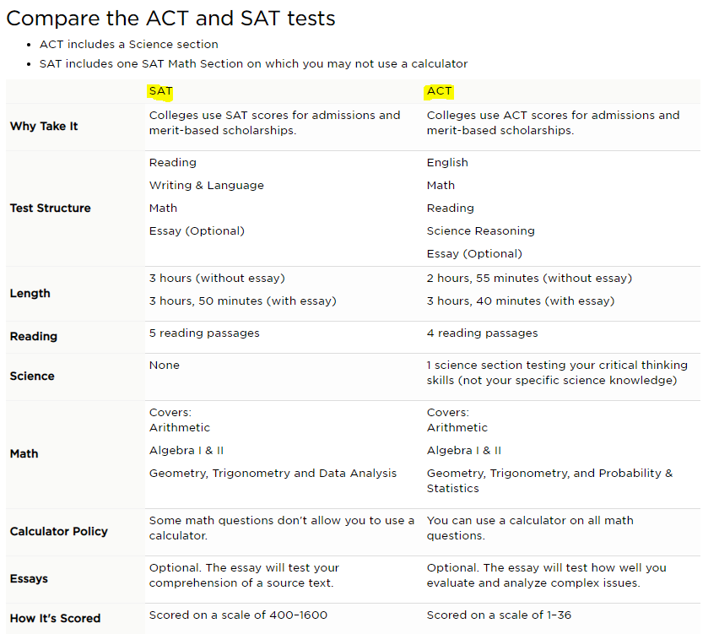
Online ACT and SAT Resources
ACT: https://academy.act.org/
SAT: https://www.khanacademy.org/
Princeton Review: https://www.princetonreview.com/offer/free-practice-tests
Notes:
Free ACT and SAT resources can be found in the North Central Counseling Office and online. ACT’s online free resource is called ACT Academy, and SAT’s free online resource is called Khan Academy. You can also access free practice tests on the Princeton Review’s website.

Slide 9
NCAA Eligibility Center
Any student wishing to play NCAA Division I or Division II athletics in college must:
Register online at www.ncaaeligibilitycenter.org
Request high school transcript through the NCAA Eligibility Center website
Send SAT/ACT scores to the NCAA through appropriate testing agency websites
NCAA code is 9999
*NCAA College Recruiting Night at North Central is Monday, August 26, 2019 at 6pm

Slide 10
Each journey to college is unique - your child needs you!
Parent | Student
Research colleges | Research colleges
Encouraged to use Naviance | Must use Naviance
Assist student in meeting deadlines | Meet deadlines
Help keep organized | Take initiative to organize
Remind child to check email | Check email
Remind students to work on/complete college applications | Work on/complete college applications and required forms
Lead on financial discussion | Work hard for scholarships
Complete parent part of FAFSA | Complete student part of FAFSA
Contact school counselor for more information | Seek counselor for assistance
Notes:
We know the college application process can be overwhelming, but we encourage you to let your student take the lead. Continue to research and visit colleges together, continue to help keep your student organized, and continue to talk about paying for college. Students should be checking their emails for important messages from colleges, completing their college applications, and completing their scholarship applications. Together, this process will become much more manageable.

Slide 11
Counseling And Advising Sessions For Seniors
Large group meeting at the beginning of Senior year
Smaller group sessions in Senior English classes
Individual meetings with counselor
Optional meetings
with Miss Salazar
Notes:
We are also going to be with your student every step of the way. We begin with a large group meeting, followed by smaller group sessions, as well as individual meetings.

Slide 12

Notes:
Are you and your student confused about the college application process?

Slide 13
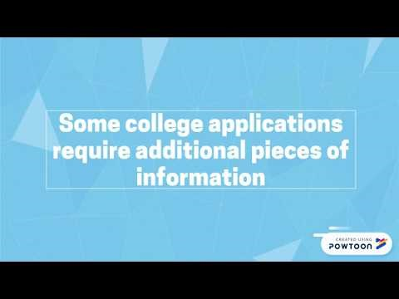
Notes:
Check out this short video.

Slide 14
Types of Applications
Non-Restrictive Application Plans
REGULAR DECISION
Students submit an application by a specified date and receive a decision in a clearly stated period of time.
ROLLING DECISION
Institutions review applications as they are submitted and render admissions decisions throughout the admission cycle.
EARLY ACTION
Students apply early and receive a decision well in advance of the institution’s regular response date.
Restrictive Application Plans
RESTRICTIVE EARLY ACTION (REA)
Students apply to an institution of preference and receive a decision early. They may be restricted from applying ED or EA or REA to other institutions. If offered enrollment, they have until May 1 to confirm.
EARLY DECISION (ED)
Students make a commitment to a first-choice institution where, if admitted they definitely will enroll. The application deadline and decision deadline occur early.
Commitment: Non-binding
Non-binding
Binding
Information from this graphic is from NACAC.org
Notes:
It is important to understand the different types of college applications.

Slide 15
When to Apply
Check application deadlines for EACH college/university
  Some programs have earlier deadlines (ex., Engineering, Nursing, Pharmacy
North Central’s deadlines:
Due date to request: *Transcript *Counselor form (ESSR) *Letter of recommendation in Naviance | College Application Deadline
OCTOBER 1 | NOVEMBER 1
OCTOBER 15 | NOVEMBER 15
NOVEMBER 1 | DECEMBER 1
NOVEMBER 15 | DECEMBER 15
DECEMBER 1 | JANUARY 1
  *Many schools have a priority deadline of November 1. Submitting your application by this date does not guarantee you will earn a scholarship, but gives you an additional chance at earning scholarship money for college.
Notes:
Because not all colleges have the same deadlines, it is important that you check with each college or university that you are applying to.
Please note the internal deadlines advertised depending on each college application’s deadline.
Remember, many schools have a priority deadline of November 1, so it is very important to have all parts of your application requested and completed by our deadlines. Submitting your completed application by this date does not guarantee that you will earn a scholarship, but we want to make sure you are given the opportunity to be considered for scholarship money.

Slide 16
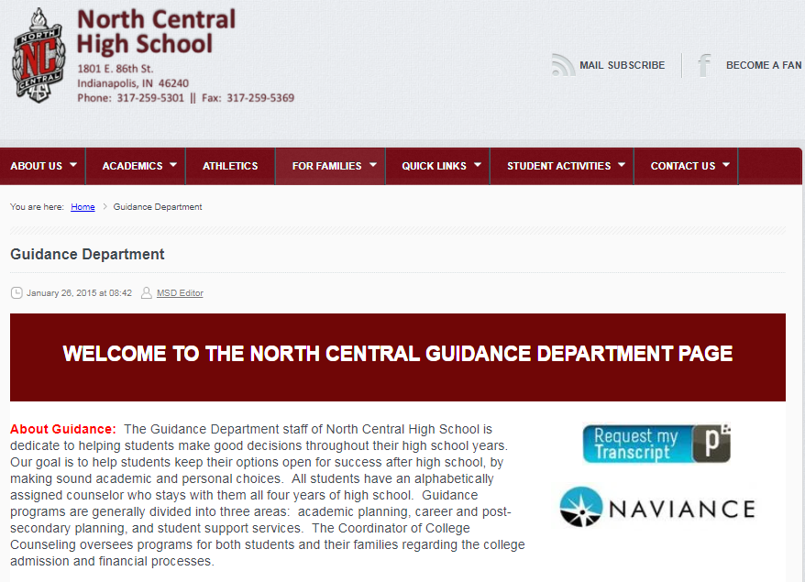
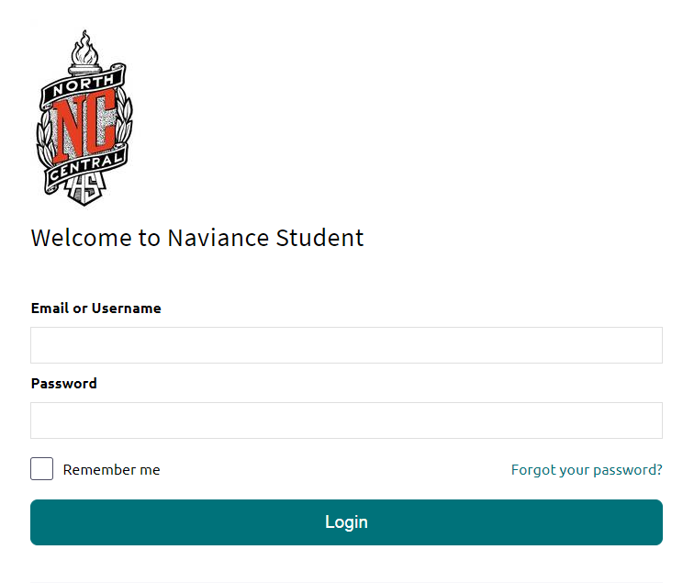
Naviance Student
1
2
STUDENT ID #
8-DIGIT BIRTHDATE (MMDDYYYY)
Notes:
Students will be using Naviance Student this year to request transcripts for the colleges they’ve applied for. In addition, students will use Naviance to sign up for college and career rep visits.
To get to Naviance Student, you will go to the North Central Counseling page. On the right hand side, you will see Naviance.
Your student’s username is their Student ID #, and your student’s password is their 8-digit birthdate.
For parents that want to access Naviance, please select “I need to register”. Your registration code is your primary phone number including area code.

Slide 17
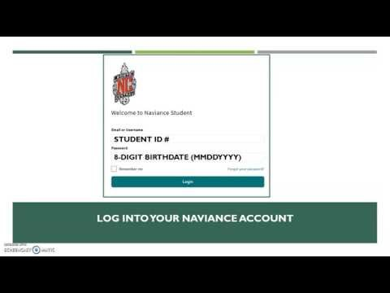
Requesting Your Transcript in Naviance

Slide 18
College and Career Visits and Presentations
New this year, apprenticeship and trade representatives will also be in attendance
College and career visits will take place on Wednesdays during p. 2 and p. 9 only
  Visits begin August 21 and go through November
Mini fair format - up to 5 representatives will be in attendance during each visit
*Students must register for these presentations in Naviance
*Students have up to 48 hours (2 school days) in advance of presentation to register
*NC teachers have final say in whether or not students may miss class time to attend the rep visit

Slide 19
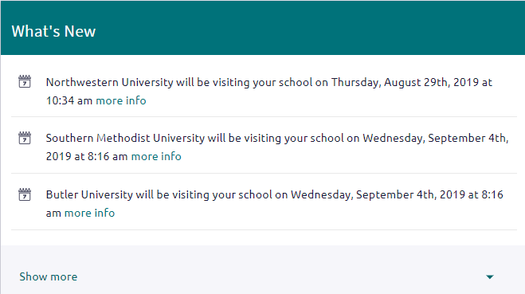
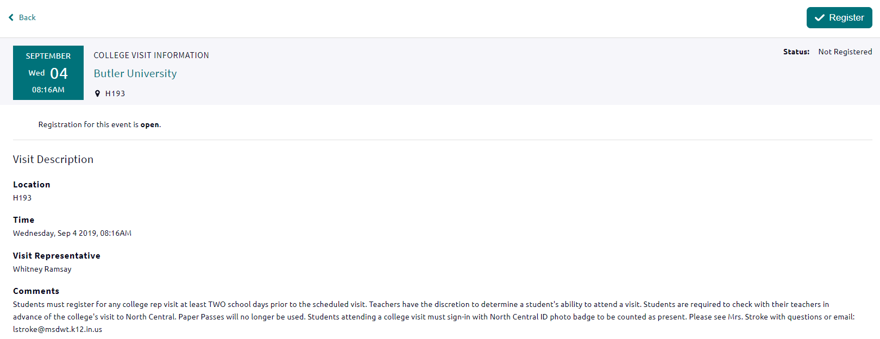
College and Career Visits and Presentations
See complete list of college and career reps that will be visiting NC in Naviance.
`
Select More Info to view the location, comments, and to register
Notes:
From the Naviance Home Screen, scroll down and check out What’s New OR go to Colleges, then select College Visits
NC teachers have the final say in whether or not students may miss class time to attend the rep visit.
No paper passes will be issued for these rep visits.
Students must sign-in at the rep visit to verify attendance

Slide 20
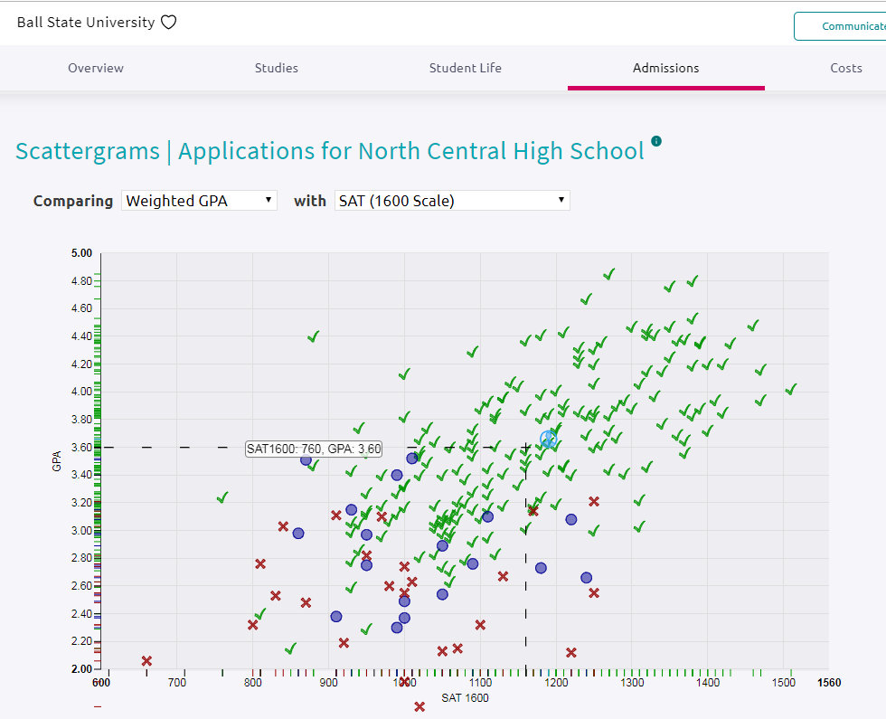
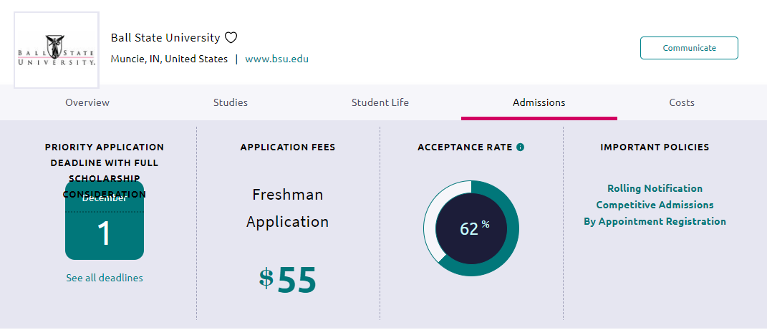
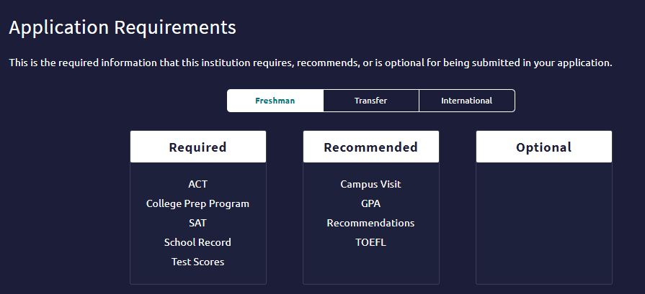
Finding the Right Fit: Scattergrams
Notes:
Finding the right fit: Scattergrams.
To get to this screen, select Colleges, under the heading Find Your Fit, you will see Scattergrams.
Here you can see an overview of the college you are considering.
You can check deadlines, see what the application fee is, look at the acceptance rate, and review important policies.
Scattergrams allows you to see how you would compare to other NC students that have applied to the same school. You can see the average GPA and SAT scores needed to get into a particular school. This is not a for sure way to determine if you will get into the school, but lets you have a good idea how you compare to other NC students. The blue circle shows where you are at on the graph. Green check marks means the student was admitted, and red X marks means the student was denied.
If you scroll to the bottom of the page, you can also view application requirements for the school you are interested in.

Slide 21
Letters of Recommendation
Is a counselor letter of recommendation required?
If yes, students must complete the Resume and Student Biography found in Naviance under Important To-Dos and Tasks on Home Screen by OCTOBER 1, 2019
Prefer paper? Go to the Counseling webpage → print and complete the Recommendation Packet under Class of 2020 College Application Materials
Is a teacher letter of recommendation required?
If yes, request the letter of recommendation in person
  Provide teacher with same Resume and Student Biography from Naviance or hand them a copy of your completed Recommendation Packet that you printed from the Counseling webpage
Give teachers ten business days to write letter
Request letter of recommendation in Naviance

Slide 22
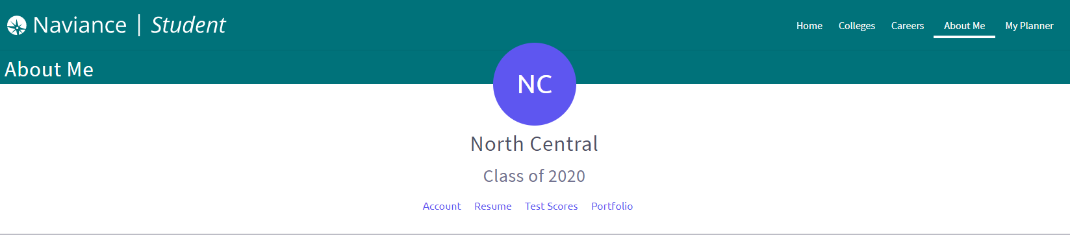
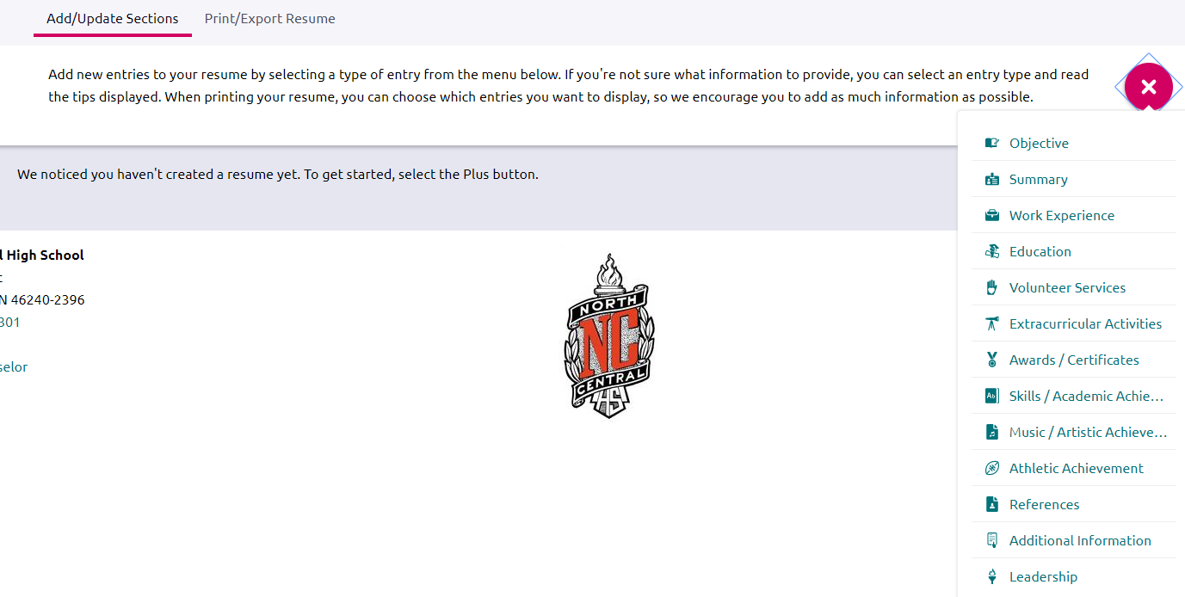
Resume
Select About Me → About Me Home, then select Resume
Notes:
Naviance has an excellent resume feature. You can access the Resume from your Naviance Home Screen under Important To-Dos and Tasks or you can select About Me, then About Me Home, then select Resume.
Click on the pink plus sign to begin adding different categories. If you’re not sure what information to provide, you can select an entry type and read the tips displayed.
Once you are done with your resume, you can print it or export it and email it to your teacher or counselor.

Slide 23

Paying for College
Net price calculator
Net price = total cost of attendance – gift aid (grants and scholarships)
Estimate college costs using personal financial/tax information
There is a Net Price Calculator on most college/university’s admissions page that estimates your costs for attending that particular college/university

Slide 24

Scholarships
Naviance provides local and national scholarship information for FREE!
Follow NC announcements for scholarship notifications
Scholarship applications updated frequently in the Counseling Office
Other reliable sources:
  College financial aid pages
  Scholarship search websites: www.fastweb.com, scholarships.com, unigo.com/scholarships
  Google
  Civic organizations
  Employers
  Local businesses
  Church groups
The Advancement Center: www.advancementcenterwts.org/scholarships/
Never pay for scholarship search services!
Notes:
Scholarships can help offset college costs.
Follow NC announcements and check the Counseling Office frequently for new scholarship postings.
Other reliable sources are college financial aid pages, scholarship search websites such as fastweb.com or scholarships.com, civic organizations, employers, local businesses, and church groups.
Don’t wait until late spring to begin your search, start now and continue to look and apply all year. Check out the Advancement Center to see which scholarships they have available for our students.

Slide 25

FAFSA
Free Application for Federal Student Aid
www.fafsa.ed.gov
Must be completed in order to receive any type of institutional/state scholarship, grant, or loan for college
FAFSA becomes available: October 1, 2019
FAFSA deadline: check with each individual college
FAFSA session with INvestEd: October 29, 2019, 3-6:30pm in the PC Lab
Notes:
The FAFSA, free application for federal student aid, becomes available on October 1.
The FAFSA must be completed in order to receive any type of institutional or state scholarship, grant, or loan for college. Be sure to check with each individual college as to their FAFSA deadline.
North Central’s FAFSA session with INvestEd is October 29 from 3-6:30pm.

Slide 26
Comparing Schools
Notes:
As you begin to look at the sticker price for each college, it is important to note that the total cost of attendance is different than the final cost. If you look at the college comparison chart above, you will see that to attend IUPUI, it is $20,018. After scholarships and grants are factored in, the final cost to attend IUPUI for this particular student is under $8,000.
We will be posting the College Comparison Chart on the Counseling website. You can modify this document with your college’s particular information.

Slide 27

Help from Miss Salazar, Coordinator of College and Career Counseling
Senior English Class discussions – August/September
Small group meetings – after school
  Sign up in Naviance
College application help sessions – after school and evening sessions available
  Sign up in Naviance
Individual appointments
Notes:
The Parent/Student Night is just the first of many meetings that we will be offering this fall to help your senior student.
Senior English Class discussions will be held in August/September
Small group meetings after school will be available for your student
We will have 4 College Application Help Sessions – 2 will be held immediately after school and 2 will be held in the evening. This isn’t a formal program, just show up and ask your application questions
Still have questions, email Miss Salazar regarding an individual appointment

Slide 28

Closing Thoughts
Be sure your email address is up-to-date in Naviance – both parent and student
  Communication regarding important items/tasks will be sent out via Naviance
Record your usernames and passwords to help keep yourself organized
Did you ask a counselor or teacher to write you a letter of recommendation? If yes, express gratitude by writing a formal thank you note
Take a deep breath, the North Central Counseling staff is here to help!

