Slide 1
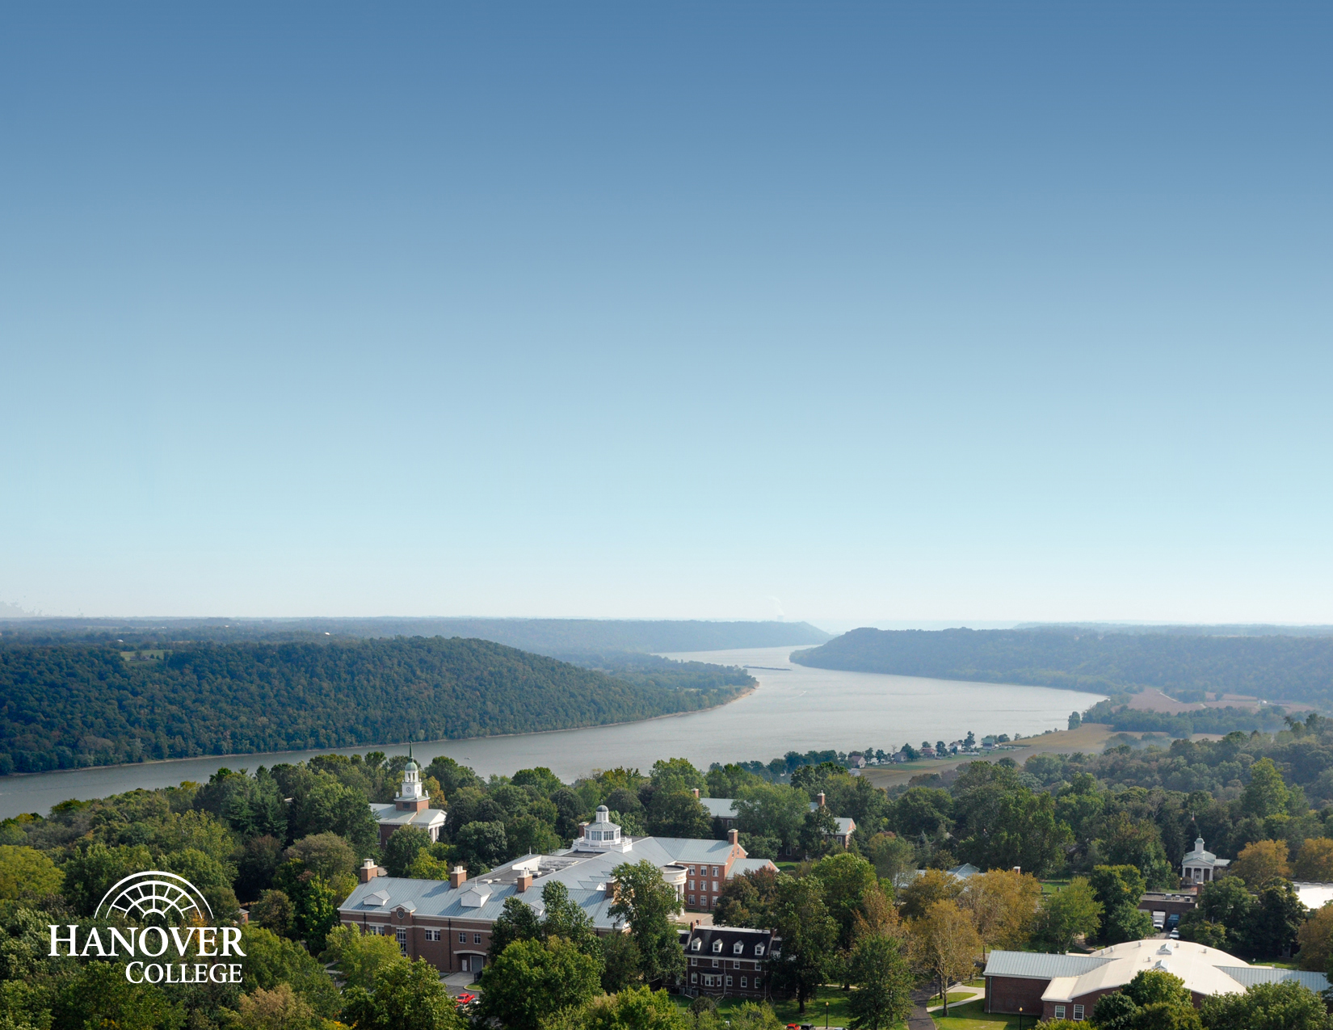
Getting the Most Out of Your College Visit
Aimee Rust-Scheuermann
Sr. Associate Director of Admission, Hanover College
Notes:
Introduce myself and my experience – 20 years enrollment management; private colleges and high schools; chaired the Indianapolis National College Fair for over 5 years;

Slide 2
Things to do BEFORE your visit…
Notes:
Do your research
By the time you visit you should already know about the school
Things you like
Things you want to know more about
Decide what visit option is best for you
Tour Only
Preview Day or Open House
Individual Visit (meetings with admission, professors and coaches)
Overnight Visit
Shadow Program

Slide 3
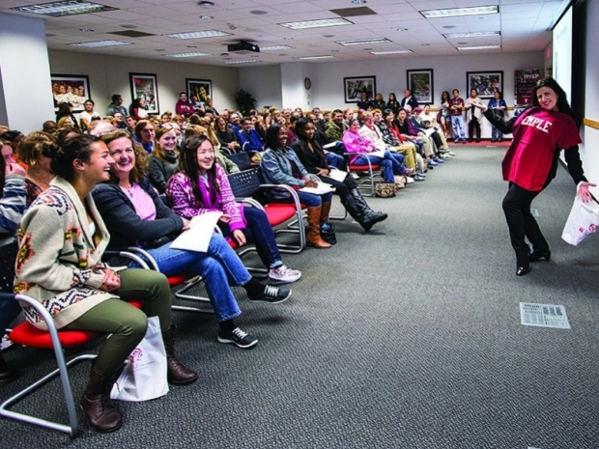
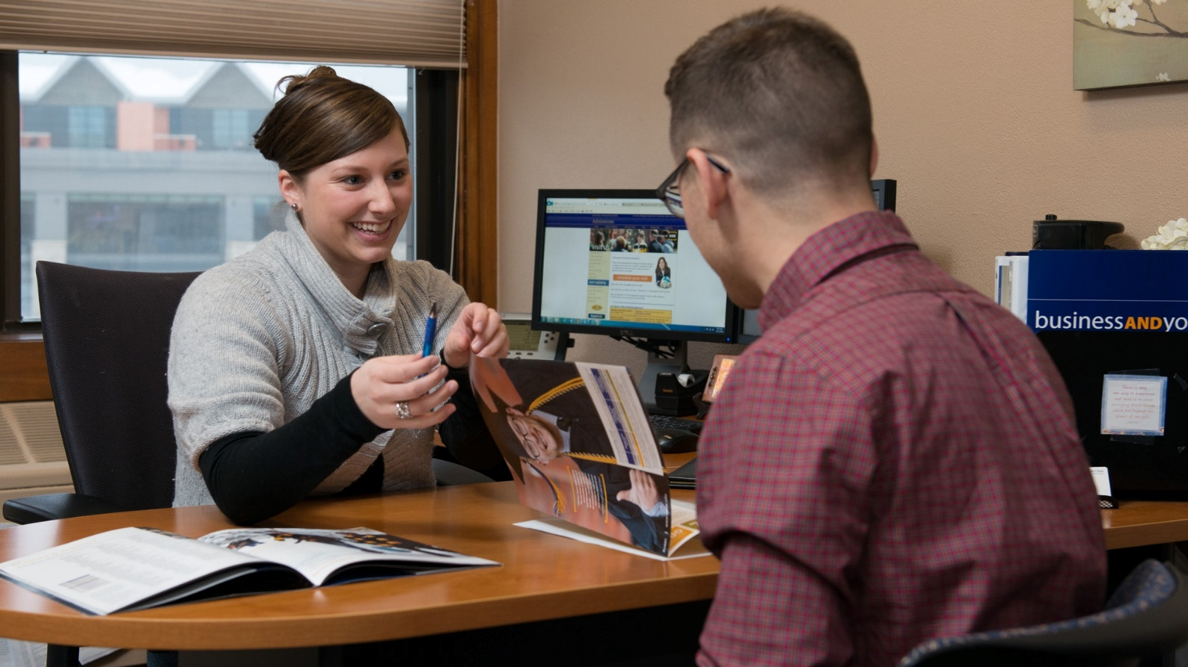
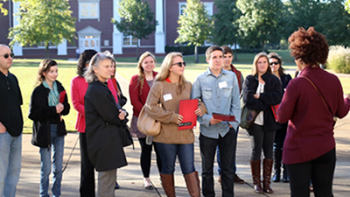
Decide Your Type of Visit
Notes:
Think about the calendar
Visit when school is in session and college students are on campus
Decide what visit option is best for you
Tour Only
Preview Day or Open House
Individual Visit (meetings with admission, professors and coaches)
Overnight Visit
Shadow Program
How do you register for these programs? Call? Online?

Slide 4
Prepare your elevator speech!
Notes:
Have an elevator speech ready to go – a quick intro:
Who I am
What I’m looking for in my college experience
Where I’m looking (close, far away, all over)
How I will make my decision (financial aid? Major? Sports?)
Why (Why should I choose this school?) = ROI

Slide 5
Things You Need to Know…
You’re not the only one evaluating your visit
Don’t rush to judgment
It’s okay to trust your gut
You don’t know if you don’t ask
Notes:
You’re not the only one evaluating your visit
Don’t rush to judgement
It’s okay to trust your gut
You don’t know if you don’t ask

Slide 6
What NOT to do…
Notes:
Do your research
By the time you visit you should already know about the school
Things you like
Things you want to know more about
Decide what visit option is best for you
Tour Only
Preview Day or Open House
Individual Visit (meetings with admission, professors and coaches)
Overnight Visit
Shadow Program

Slide 7
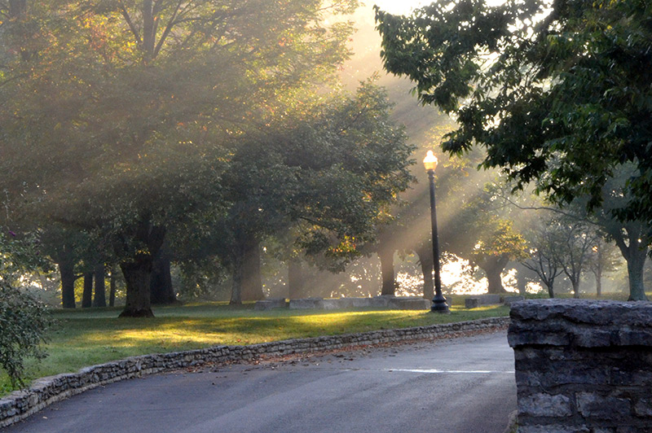
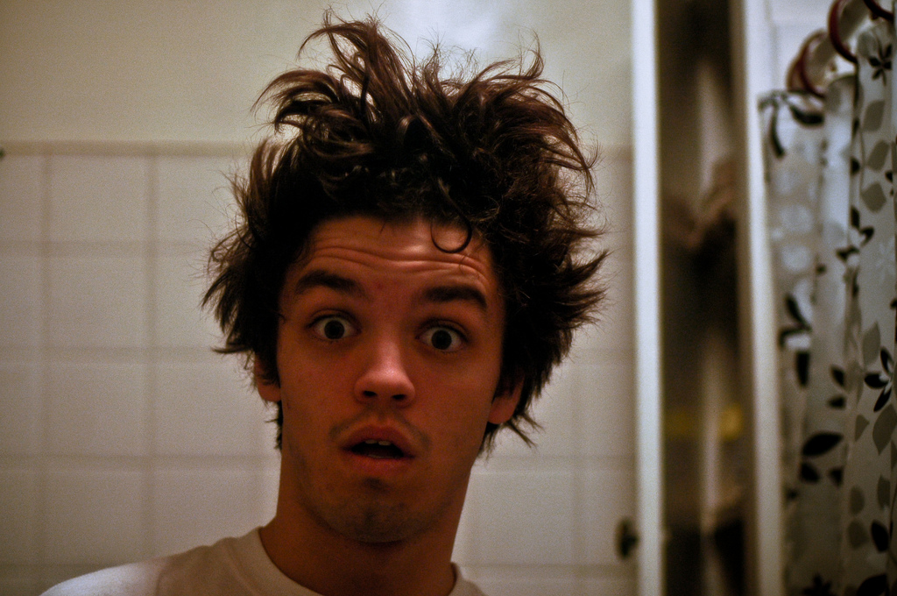
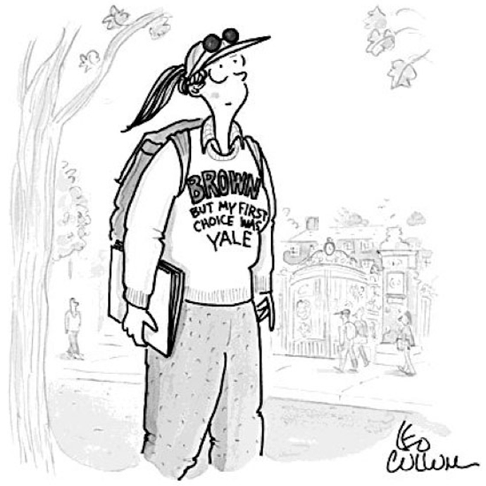
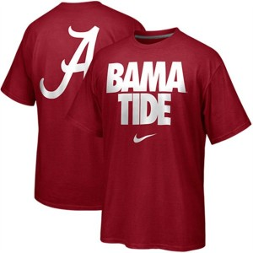
Notes:
These are EACH examples of ways students have dressed for their campus visits. UNACCEPTABLE!!!!

Slide 8
Things to do AFTER your visit…

Slide 9
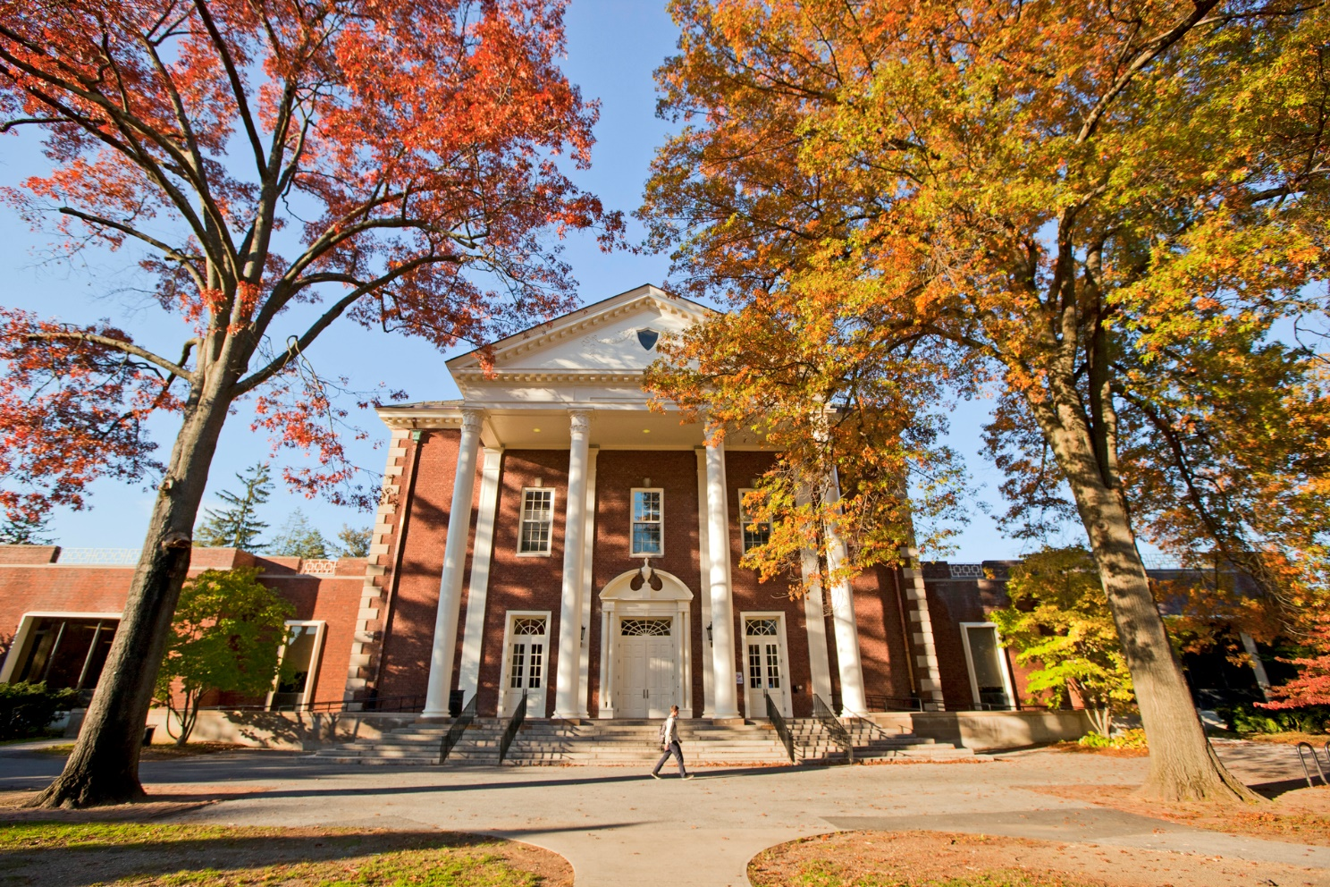
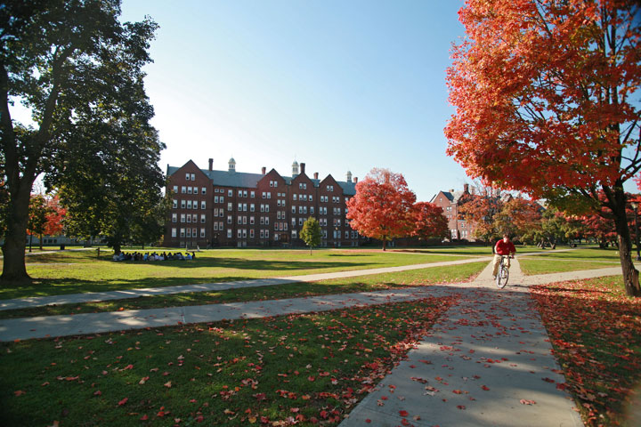
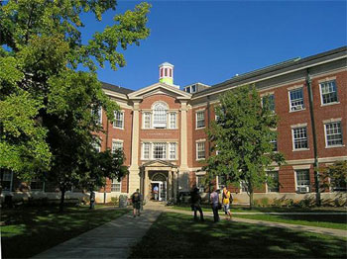
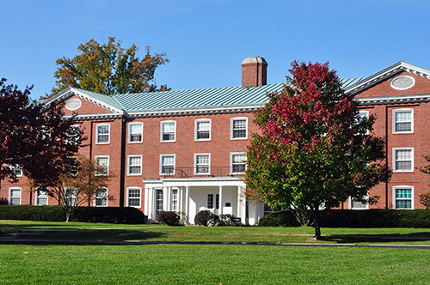
Feel
Like
Observe
Wonder
Notes:
Write things down…. FLOW
Verbally debrief your experience – Use the car ride to process
Feel, Like, Observe, Wonder
Keep an active file of all of the schools you’re interested in

Slide 10
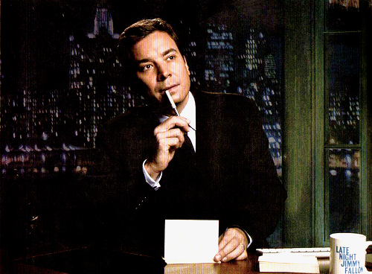
Actively Follow Up
Notes:
Send a message to your admission counselor
Visit again if necessary
Ask questions when you have them

Slide 11
Questions?
Aimee Rust-Scheuermann
Sr. Associate Director of Admission
Hanover College
rust@hanover.edu – 317.619.2692

