Slide 1

Junior Meeting
“Inside the Admission Office”
North Central High School
March 21, 2017
Susie Bremen
Coordinator for College Counseling

Slide 2
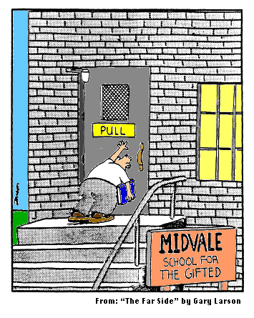

Slide 3
The College Handbook
Admission Statistics –
  Class of 2016
Beginning Your Search
The North Central Process
Required North Central Forms

Slide 4
The College Handbook
Resources
Testing
The College Visit
Financial Aid & Scholarships
Glossary of College Terms

Slide 5
Focus on These Issues Now
Plan a senior schedule that reveals that you are working at your potential – RIGOR is key
Make a list of most important criteria (p. 13)
Not knowing your major or career is OK
Learn the facts about colleges of interest and get a sense of the campus atmosphere

Slide 6
Focus on These Issues Now:
GET ORGANIZED:
  In a planner for college search – mark potential dates for visiting, prepping for tests, taking tests, & deadlines for applications & scholarships
Take both ACT & SAT by the end of junior year & repeat senior year
Career & interest resources help target potential majors:
  www.learnmoreindiana.edu
  www.collegeboard.org
  www.mappingyourfuture.org

Slide 7
Focus on These Issues Now:
Sign up with www.Parchment.com
Explore college websites, sign-up for mailing lists & take virtual campus tours
VISIT CAMPUSES (pp. 44-47)
During & after campus visits, record your impressions – Can you see yourself there?
Start filling out the Common Application

Slide 8
Things To Do This Summer
Build a resume for college applications – review sample resume (p. 36)
Do something to discover more about yourself or your interest in a potential career (p. 33)
Use the web & campus visits to narrow your college list to 5-10 choices by the beginning of senior year
Familiarize yourself with application deadlines
for admission, scholarship & financial aid
Test Prep, Test Prep, Test Prep - prior to retaking tests senior year (pp. 39-43)

Slide 9
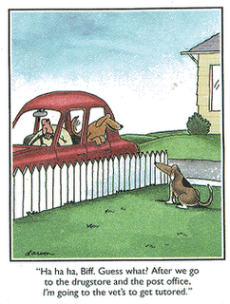
GET TUTORED!

Slide 10
Your Counselor & the Guidance Office
Involve your counselors!
  Help you target your college choices no matter what your GPA
  Help you assess your odds of getting in & offers strategies
  Help students with special talents, such as artists, musicians & athletes
  Help for 1st Gen, 21st Century Scholars, students from low income backgrounds, etc.

Slide 11
College Application Issues
Rankings can be used in initial stage of compiling a list of colleges, but don’t over rely on them
Apply to one affordable college within one hour of home as a “safety” measure
Early HS graduation is NOT recommended

Slide 12
College Application Issues
AP test scores are not a required element of the application – submit scores if you rocked AP tests; credit is awarded when you register
Athletes – work with your coach for tips about your process (p. 38)
Visual & Performing Artists: portfolios & auditions are key to your process

Slide 13
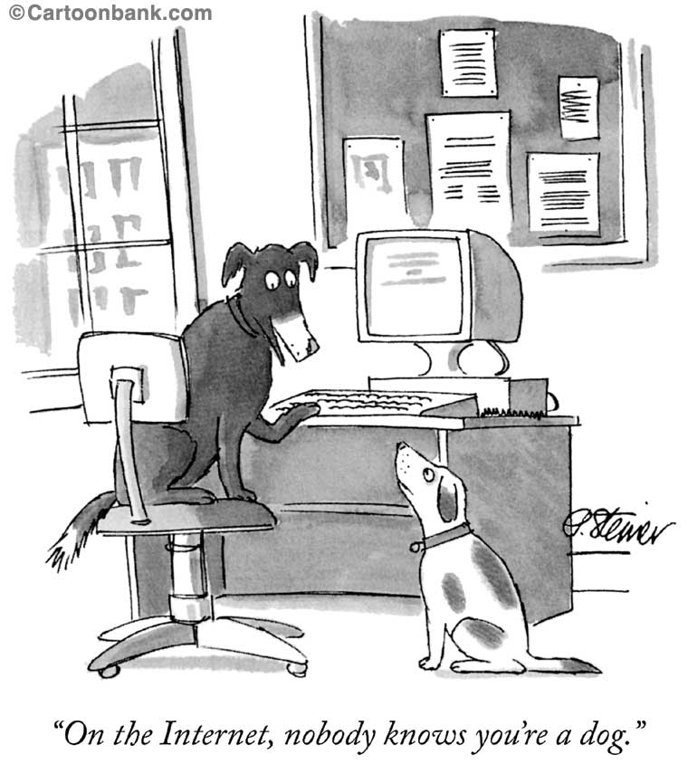
Apply Online!

Slide 14

(Re)Introducing
        NAVIANCE Family Connection

Slide 15

NAVIANCE http://connection.naviance.com/northcentral
Premiere Web-based
College Planning System
REQUIRES A VALID E~MAIL ADDRESS
Research Colleges, Careers & Scholarships
Sign-up to meet with visiting college reps
Get college updates from Guidance

Slide 16
NAVIANCE http://connection.naviance.com/northcentral
Live links to sites of interest
Summer enrichment programs
Track the entire college search process
Login instructions can be found in your College Handbook (p. 8) and on NC’s website under ‘For Families/Guidance’

Slide 17
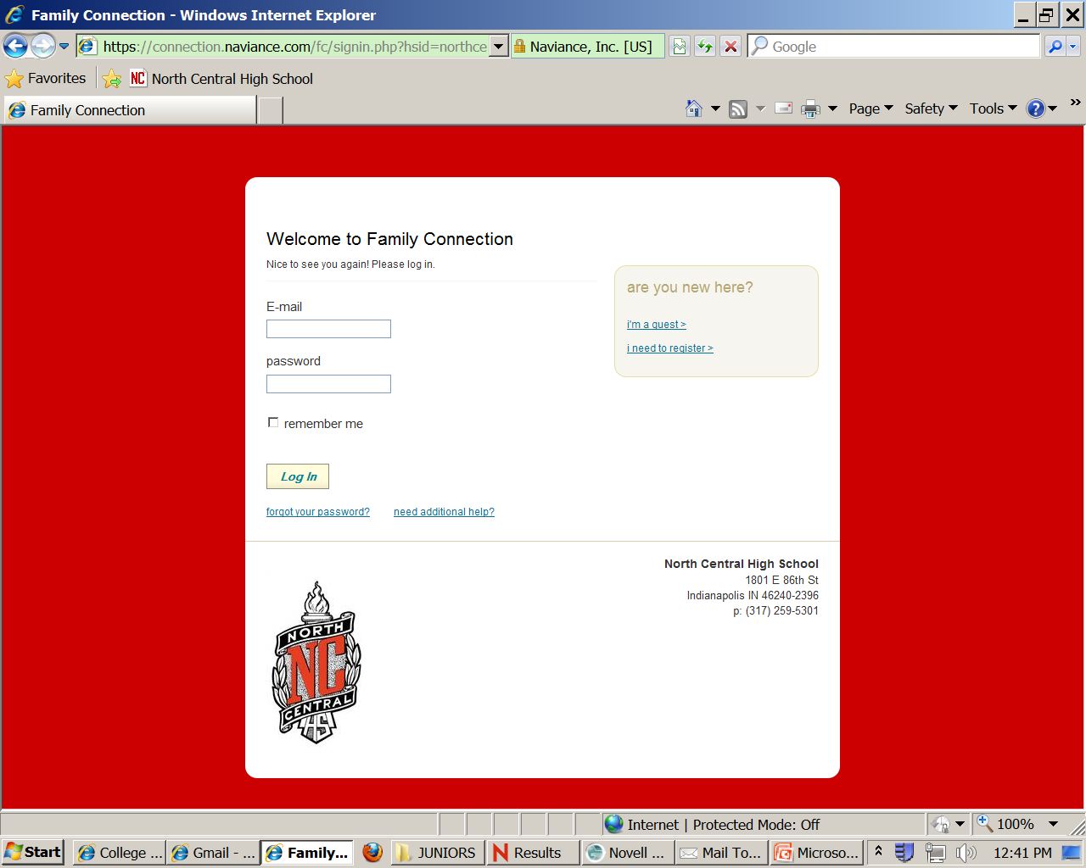
NAVIANCE Registration Page

Slide 18
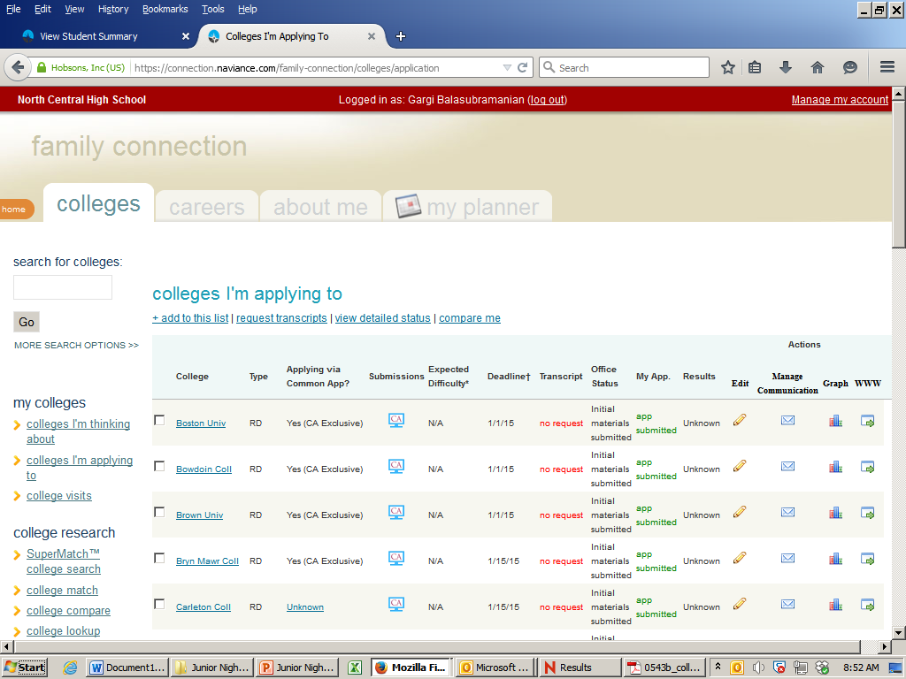
NAVIANCE: College Applications

Slide 19
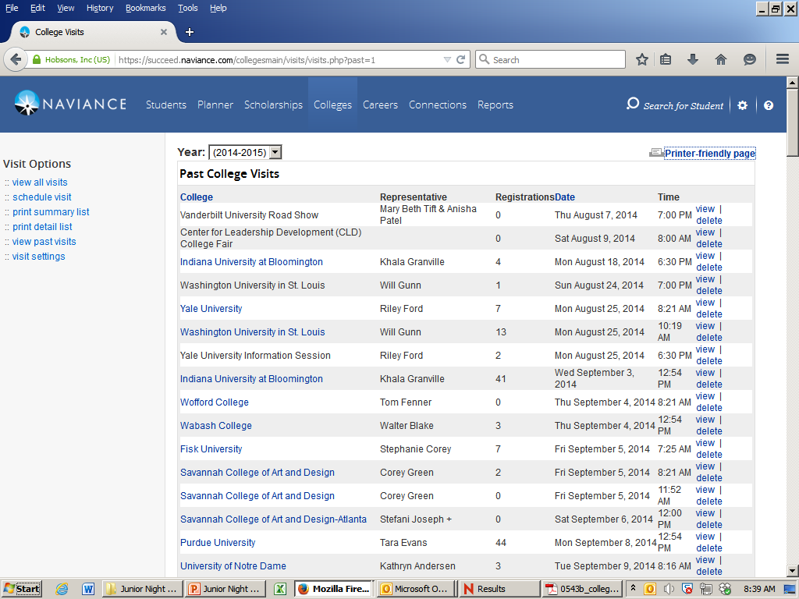
NAVIANCE: College Visits

Slide 20
Electronic Transcripts
PARCHMENT www.parchment.com/join
Register now! (p. 10)
Return to the site to add colleges
Request electronic transcripts for the schools to which you apply

Slide 21
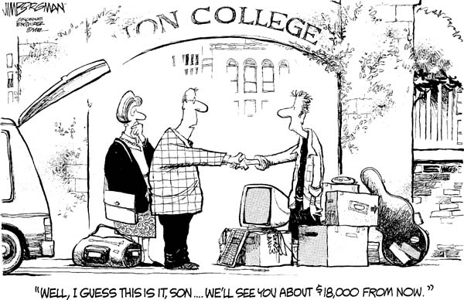

Slide 22
$$$ for College
Apply for financial aid early in your senior year (based on ‘prior prior year’), (p. 48)
  # in household, age of parents, # in college, income = EFC
Admission applications often serve as initial scholarship screening
Need-based & merit scholarships: www.cappex.com
www.collegeboard.org/scholarships
www.unigo.com

Slide 23
$$$ for College
Outside “Scholarship Season” begins in January
  Use online scholarship search tools
  Be willing to write essays
  Demonstrated leadership
  Service to others
  Many awards focus on demonstrated financial need and 1st Generation students

Slide 24
Upcoming Programs
Princeton Review FREE Practice ACT
    Saturday, APRIL 29, 9:00 am – 1:00 pm
  Princeton Review FREE Practice SAT
    Sunday, MAY 7, 12:30 pm – 6 pm
  Register online: www/PrincetonReview.com/FreePracticeTest

Slide 25
Upcoming Programs
ZAPS ACT & SAT Seminars
  Watch for fall 2017 dates
  Cost $89.99
    Includes Study Guide & Training Workbooks
  Register online:
    www.zaps.com or 1-877-927-8378

Slide 26
Help from College Coordinator
Meet with seniors all year
Add juniors second semester
Appointments scheduled after the
My College Search form is returned
Join REMIND for updates:
  Text ncgrad2018 to 81010

Slide 27
College Admission “Boot Camp”
JUNE 1 – 2*
12:30-5:30 pm AND 8:30 am-5pm *
* DATE & TIMES SUBJECT TO CHANGE
$100.00 registration fee
College & Scholarship research, application essay writing, Naviance & Parchment training
Scholarships available to students who receive free/reduced lunch or textbook assistance
Application forms available in Guidance Office beginning Friday, APRIL 14

Slide 28


Slide 29
Princeton Review Prizes
“And the Winner Is…”

Slide 30
Talk
to the
Colleges

Slide 31
Break-Out Sessions
University of Alabama (L249)
University of Chicago (B123)
Indiana University & Purdue University
  (Auditorium)
    Changes in admission standards
    New programs & developments
    Tips for applicants
    Merit scholarships
    Campus Visits

Slide 32
Don’t rush off!
d
Stick around for a great discussion

