Slide 1
Freshman & Sophomore
College and Career Night
Welcome
Classes of
2019 - 2020
North Central High School Guidance Department

Slide 2

  Diploma Options
  Course Information
  Career Planning Information
  • College Information

Slide 3
Diploma Options
Core 40 (Default Diploma)
Core 40 - Academic Honors
Core 40 - Technical Honors
North Central Academic Honors
International Baccalaureate
Basic

Slide 4
Core 40 Diploma
English: 8 credits
Math: 6 credits - Algebra ½, Geometry ½, Algebra ¾
Science: 6 Credits - Biology, Chemistry, Physics or ICP
and 2 additional Science classes
Soc. Studies: 6 credits - World History or World Geog.- gr. 9
US History – gr. 10 and Govt & Econ – gr.12
PE: 2 credits Health: 1 Credit
Technology: 1 Credit Speech: 1 Credit
Electives: 16 credits
Total : 47 Credits

Slide 5
Core 40 Diploma
Quantitative Reasoning (QR) Courses
“students must take a Math or
QR Course each year in
High School”

Slide 6
Core 40 with Academic Honors
Meet ALL Core 40 requirements
2 additional math credits - 8 cr.
Total of 49 credits
Fine Arts - 2 credits
World Language - 6 or 8 credits
    3 years of 1 language or 2 yrs each of 2 languages
3.0 GPA & no grade lower than C-
External Requirements

Slide 7
Core 40 with Technical Honors
Complete Core 40 requirements and:
6-10 credits in career classes
C- or above in required courses
3.0 GPA
External Requirements

Slide 8
North Central Academic Honors
Core 40 with Academic Honors
Take 20 X, AP/IB or ACP courses
YOU choose 20 Xs in YOUR areas of strength
Take Chemistry or Physics (not ICP)
Include Precalculus
3.0 GPA
49 credits, no grade lower than C-

Slide 9
IB Diploma Program
Prescribed Curriculum
2 year program (Grades 11 & 12)
Apply toward end of Grade 10
Keep IB option open by taking:
English 10X, AP/IB US History, Chemistry, Algebra 3/4, Language X
For more information contact:
Mr. Bill Gulde
wgulde@msdwt.k12.in.us

Slide 10
End of Course Assessments
Determines graduation
Students must pass ECAs in:
Algebra 1
English 10
Student must participate in:
Biology
ECAs are given upon completion of the course
Multiple opportunities to test
Waiver is possible

Slide 11
Course Options . . .
Complete the following by the end of Grade 10
  2 semesters of Physical Education - only 1 can be in summer
  Health
  Speech
  Technology – take a class or the tech test

Slide 12

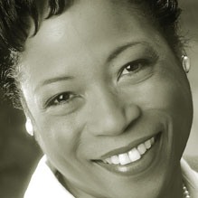

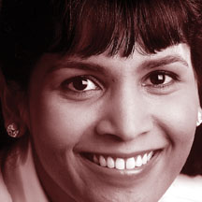
Exploring Career Options
Reach for the Stars
Rosie Jordan
Career Consultant phone: (317) 291-9824

Slide 13
Holland Theory
Realistic
Investigative
R
I
Conventional
C
A
Artistic
E
S
Enterprising
Social

Slide 14
Subjects & Skills by Theme
R
Realistic
Academic Majors
Subjects: physical education, horticulture, military science, earth science, drafting, auto body
Skills: assembling, designing, measuring, operating equipment
Agriculture, horticulture
Engineering
X-ray technology
Trades like carpentry, plumbing, electrician
Military

Slide 15
Subjects & Skills by Theme
I
Investigative
Academic Majors
Subjects: math, science, electronics, anatomy, psychology, astronomy
Skills: analyzing, diagnosing, examining, problem solving
Pharmacy
Biology
Chemistry
Dentistry
Mathematics
Medicine
Veterinary medicine

Slide 16
Subjects & Skills by Theme
A
Academic Majors
Artistic
Subjects: journalism, creative writing, music, drama, art
Skills: creating, improving, inventing, seeing possibilities
Architecture
English/Writing
Broadcast journalism
Graphic Arts
Law
Performing arts
Public relations

Slide 17
Subjects & Skills by Theme
Social
Academic Majors
S
Subjects: sociology, elementary education, child development, health
Skills: caring for people, training, collaborating, communicating warmth
Child Development
Counseling
Elementary education
Nursing
Social Work
Religious Studies

Slide 18
Subjects & Skills by Theme
Enterprising
Academic Majors
E
Subjects: speech, debate, marketing, business management, civics
Skills: developing trust/rapport, leading, persuading, selling ideas/products
Business Administration
Management
Marketing
Political Science
Speech Communication

Slide 19
Subjects & Skills by Theme
C
Conventional
Academic Majors
Subjects: accounting, bookkeeping, computer operation, office practices
Skills: estimating, following through, knowing rules and procedures, organizing data
Accounting
Computer and Information Sciences
Consumer Economics
Hospital Administration
Nutrition

Slide 20
Career Action Plan
Study, study, study!
Know your skills
Know what kind of work you want to do (identify interests)
Do some research
Talk to people who are doing it
Shadow people when appropriate
Get experience: as a volunteer, through extracurricular activities, and work

Slide 21
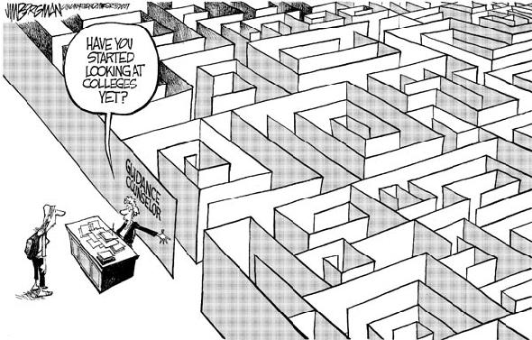

Slide 22
Freshmen College Planning Tips
Earn the best grades you can
Take advantage of NC’s resources
Learn More Indiana (learnmoreindiana.org)
National Center for College Costs
DREAM!

Slide 23
Factors Weighed During the Application Review
The Transcript:
    GPA
    Difficulty of classes taken
    The overall academic strength of the high school

Slide 24
Factors Weighed During the Application Review
Grade trends:
    Increasingly challenging academic core classes
    Consistent or improving grades
    Class rank

Slide 25
Factors Weighed During the Application Review
• Special talents or abilities: Art, music, leadership, athletics, etc.
• Extra-curricular commitments
• Service to school and/or community
Interest
Interview

Slide 26
NAVIANCE – Family Connection http://connection.naviance.com/northcentral
Web-based college resource site
College & career search
Find summer enrichment programs
Research scholarships & financial aid
Requires a WORKING EMAIL ADDRESS

Slide 27
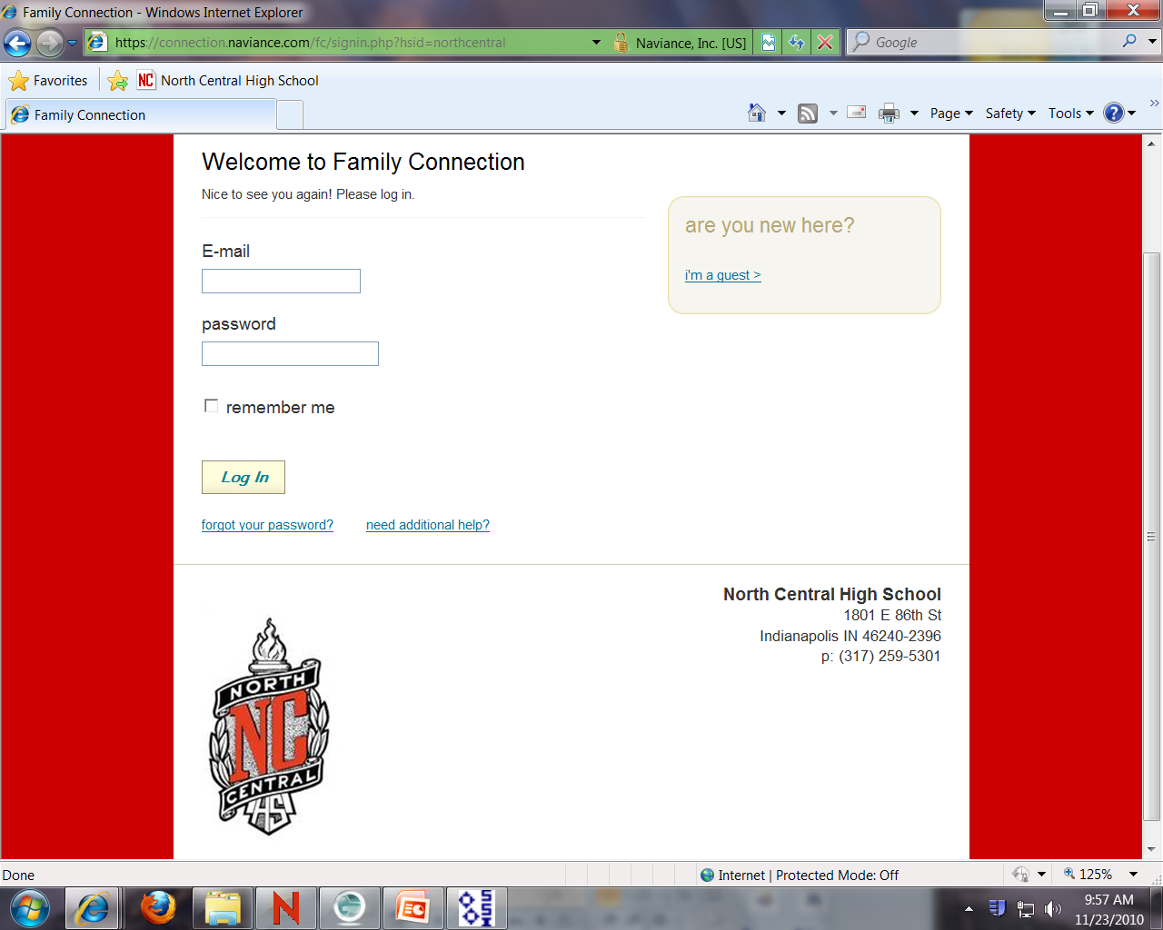

Slide 28
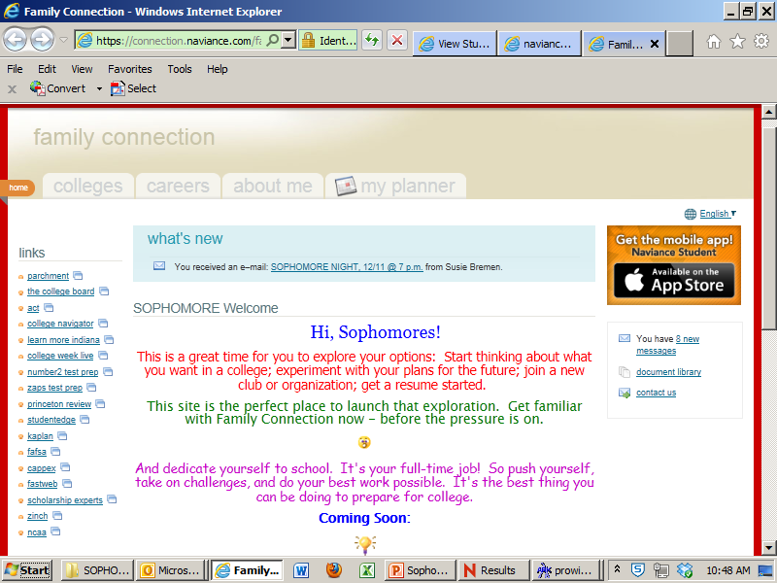

Slide 29
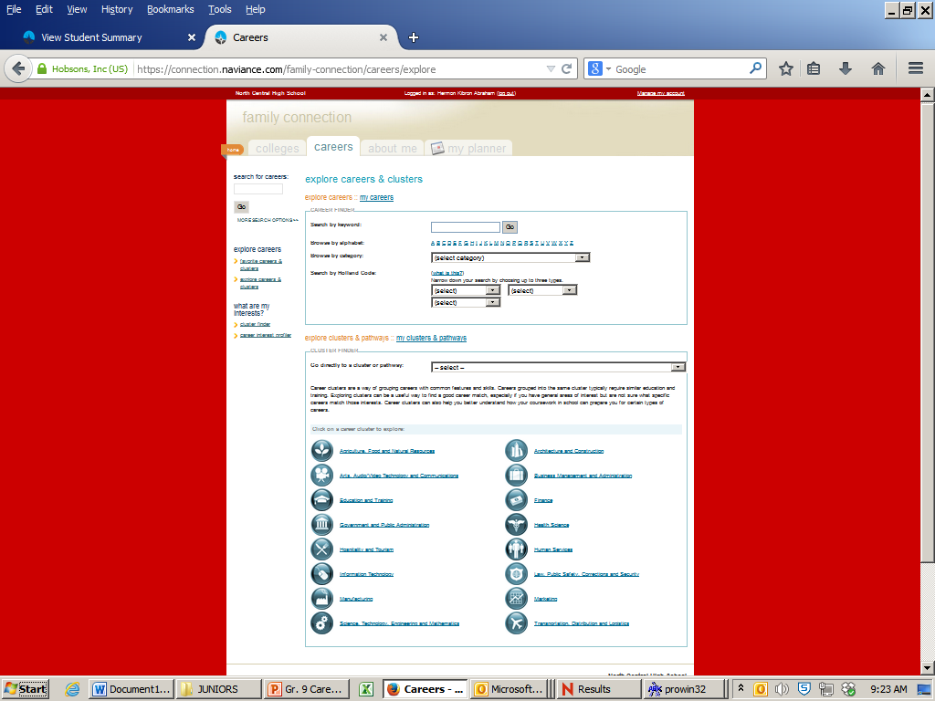
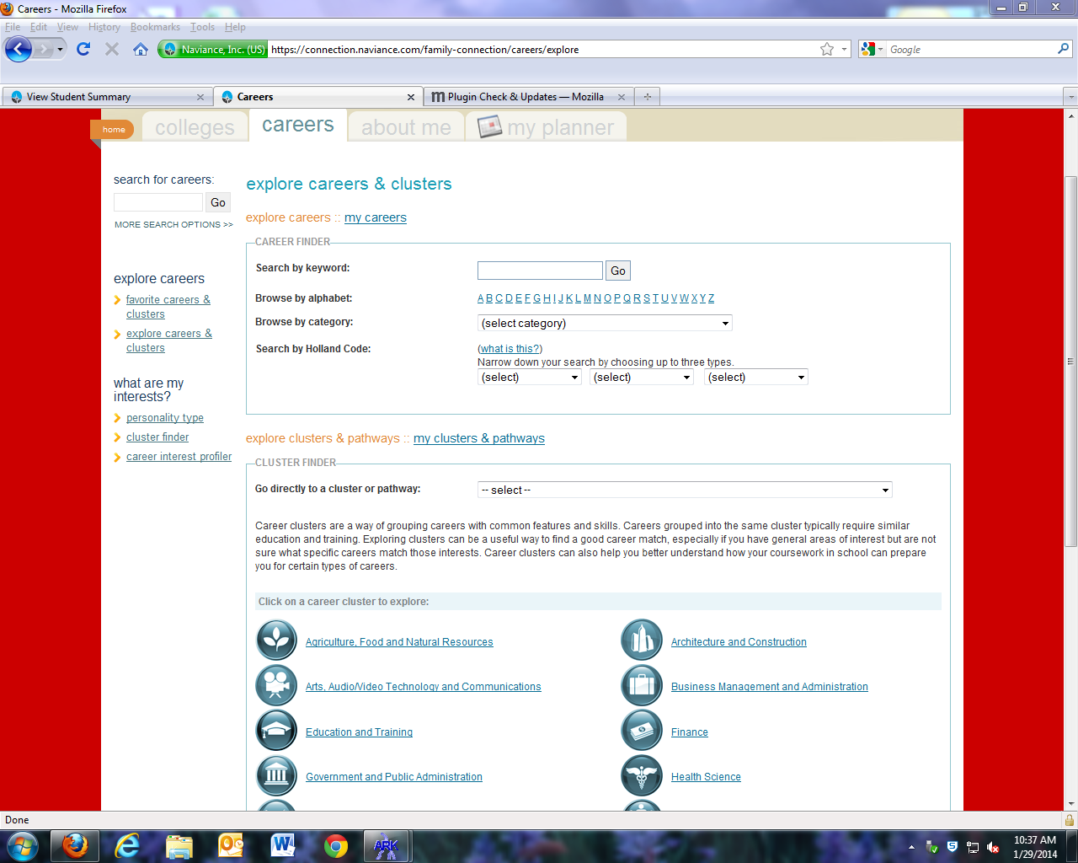
Naviance-cont’d.

Slide 30
National Center for College Costs
Complete a College cost Estimator at www.indianacollegecosts.com
Receive advice on how to make college affordable
Maximize financial aid opportunities
Email: infor@collegecosts.com
Phone: (877) 687-7291

Slide 31
Resources for Students & Parents
Guidance counselors & teachers
College & Career Fairs
College guide books
Online resources
Summer programs on campuses
Current seniors & recent alumni

Slide 32
Targets for Sophomores
Research majors & career options
Strengthen leadership skills
Summer immersion programs:
  Academic, leadership, wilderness, overseas, etc.

Slide 33
College “TO DO” List for Sophomores
Academic Planning – diploma type
Take the PSAT again in 11th grade – National Merit Scholarship Qualifying Exam (NMSQT)
Use online major & career exploration tools
Visit college website: admission requirements, campus tours, scholarships

Slide 34
Web Resources for Basics
www.review.com
www.collegeboard.org
www.act.org/path/parent
www.nacac.net
www.petersons.com
www.unigo.com

Slide 35
For College Announcements
FR - Text: @ncgrad2020 to 81010
SO - Text: @ncgrad2019 to 81010

Slide 36
And the winners of the Princeton Review books are…

Slide 37

Your NCHS Counseling Staff Thanks You For Attending!

